Slide 1
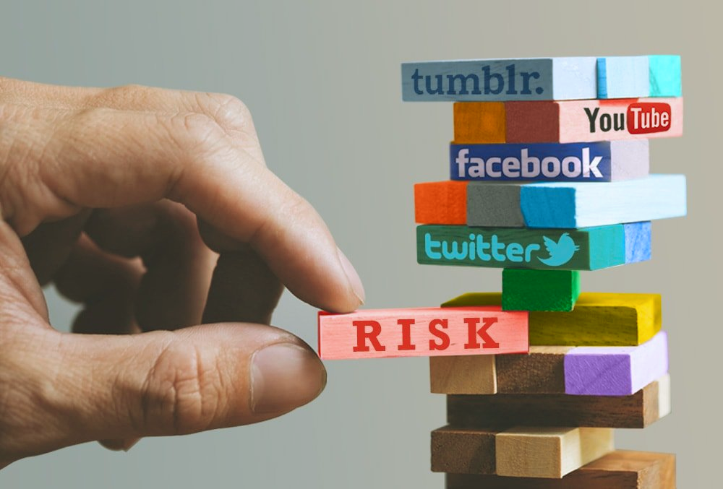

Social Media Engagement and Risky Behavior: The Role of Impulsivity and Sensation Seeking
Danny Zweben & Dr. Jason Chein

Slide 2
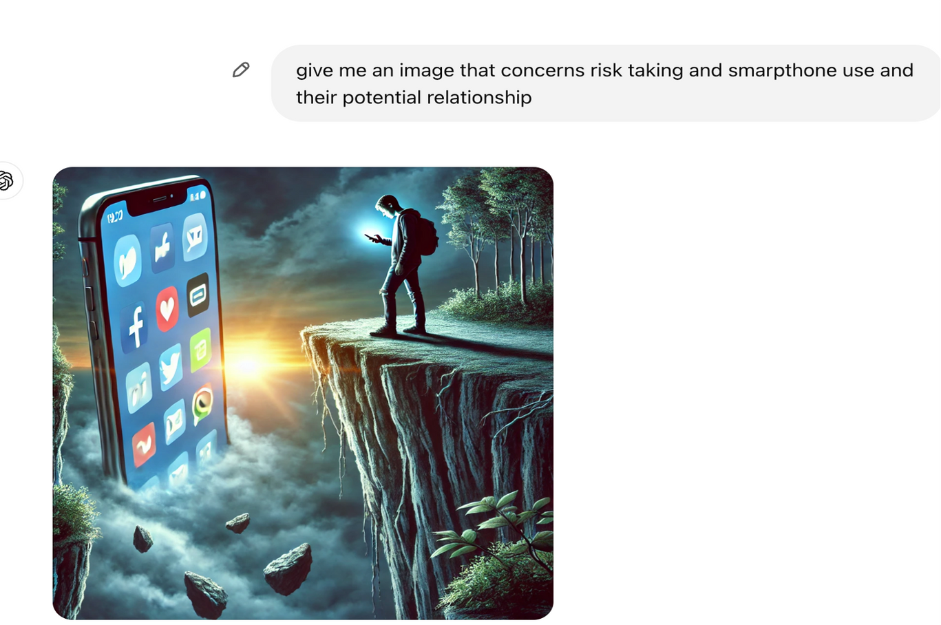
What AI thinks this relationship looks like

Slide 3
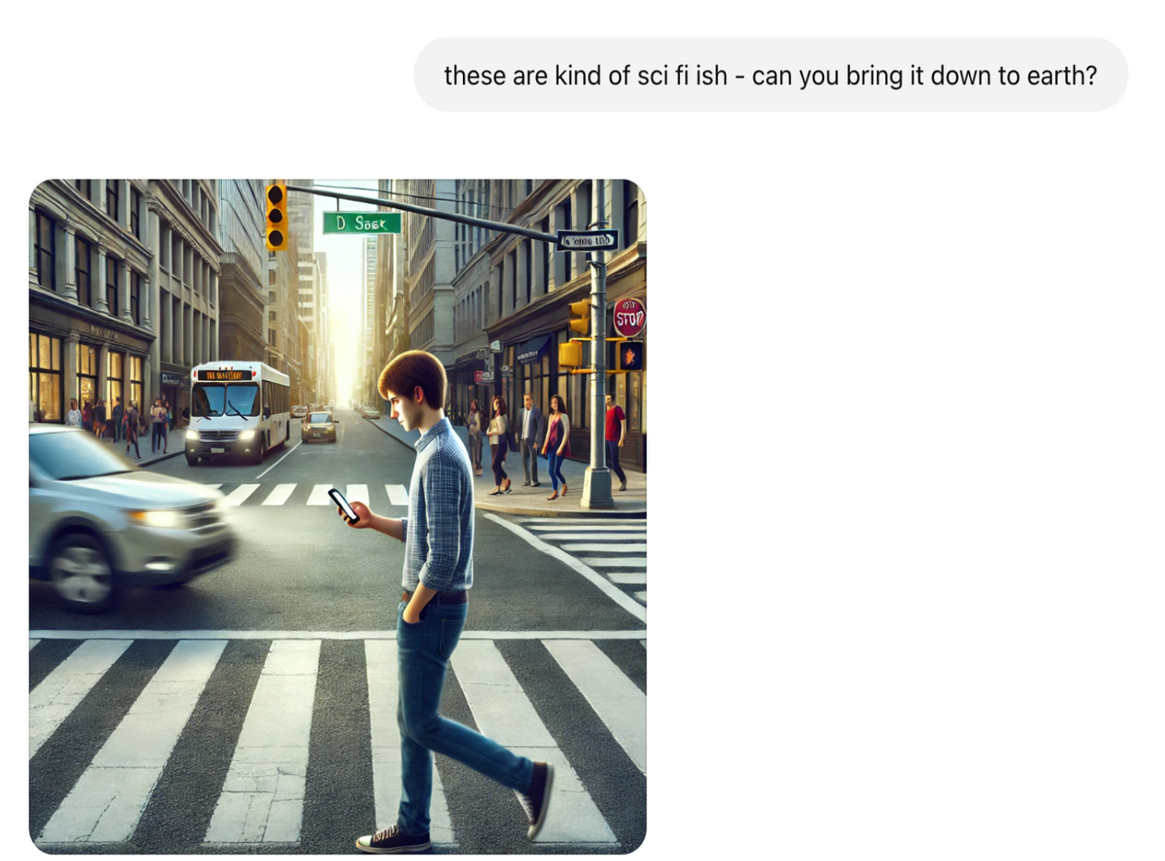
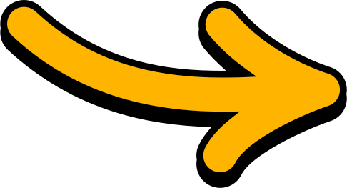
What AI thinks this relationship looks like
spot on!!

Slide 4

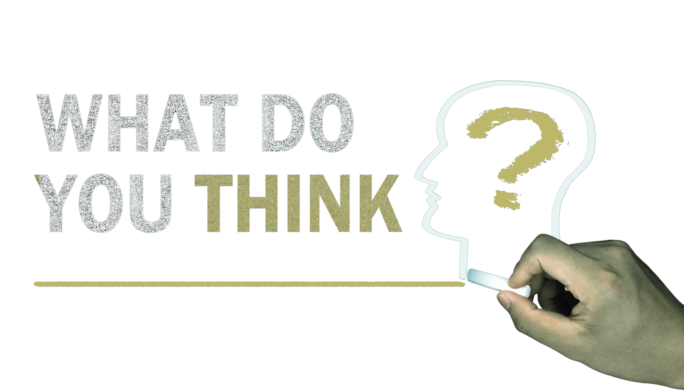
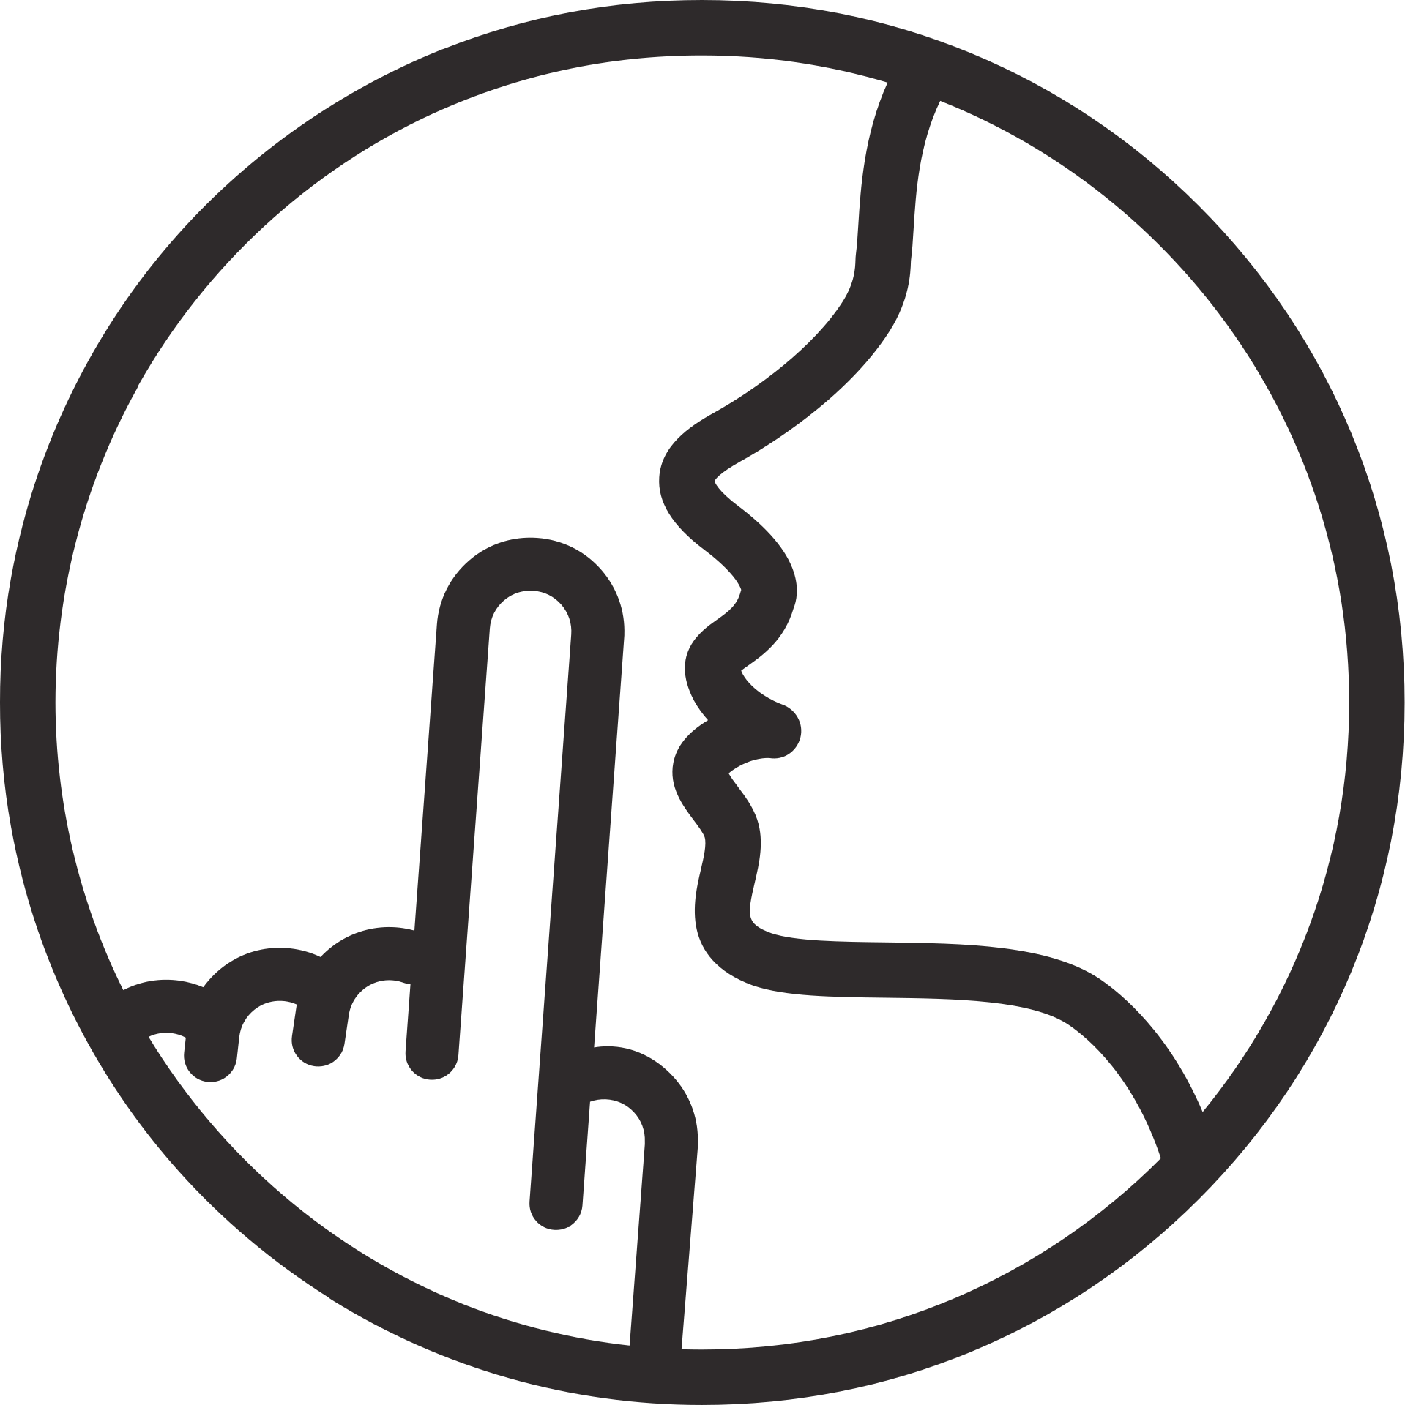
A. Smartphone an Social media (SSM) use leads to increased risk-taking behavior.
B. SSM engagement leads to reduced risk-taking behavior.
C. There is no relationship between smartphone use and social media?
(A risk-taking behavior is defined as any behavior that puts an individual ...an increased chance of harm, where the individual weighs up the possible outcomes of their actions (Sitkin & Pablo, 1992))
If you’ve researched this.....

Slide 5
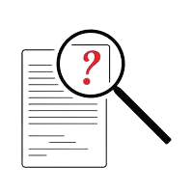
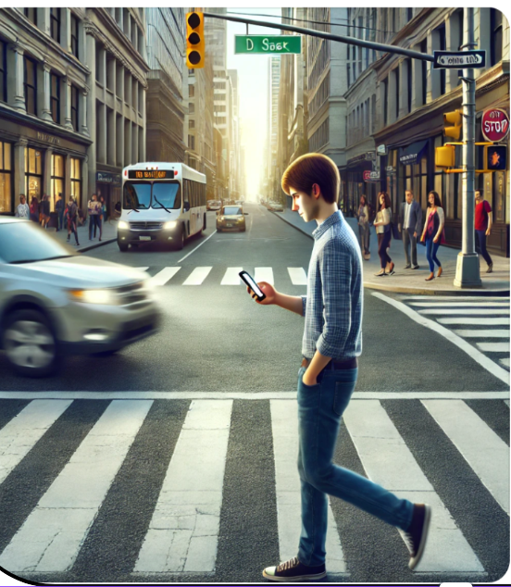
Research Qeustions
Q1: Is risk-taking propensity associated with increased SSM usage?
Does this association differ between positive risk-taking (e.g., advocating for one’s beliefs) and negative risk-taking (e.g., texting while driving)?

Slide 6
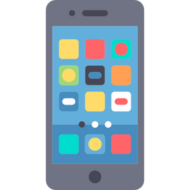
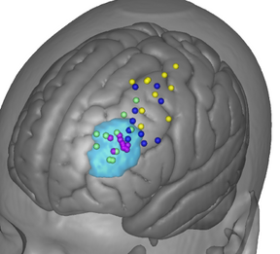
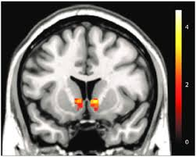
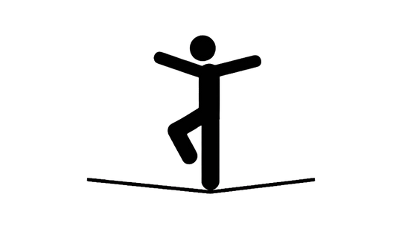
Research Qeustions
Q2: Does SSM influence cognitive mechanisms underlying risk-taking?
Q1: Does SSM influence cognitive mechanisms underlying risk-taking? Is social media use associated with reduced executive functioning and impulse control, as well as heightened sensation seeking—mechanisms previously linked to risk-taking behavior?

Slide 7

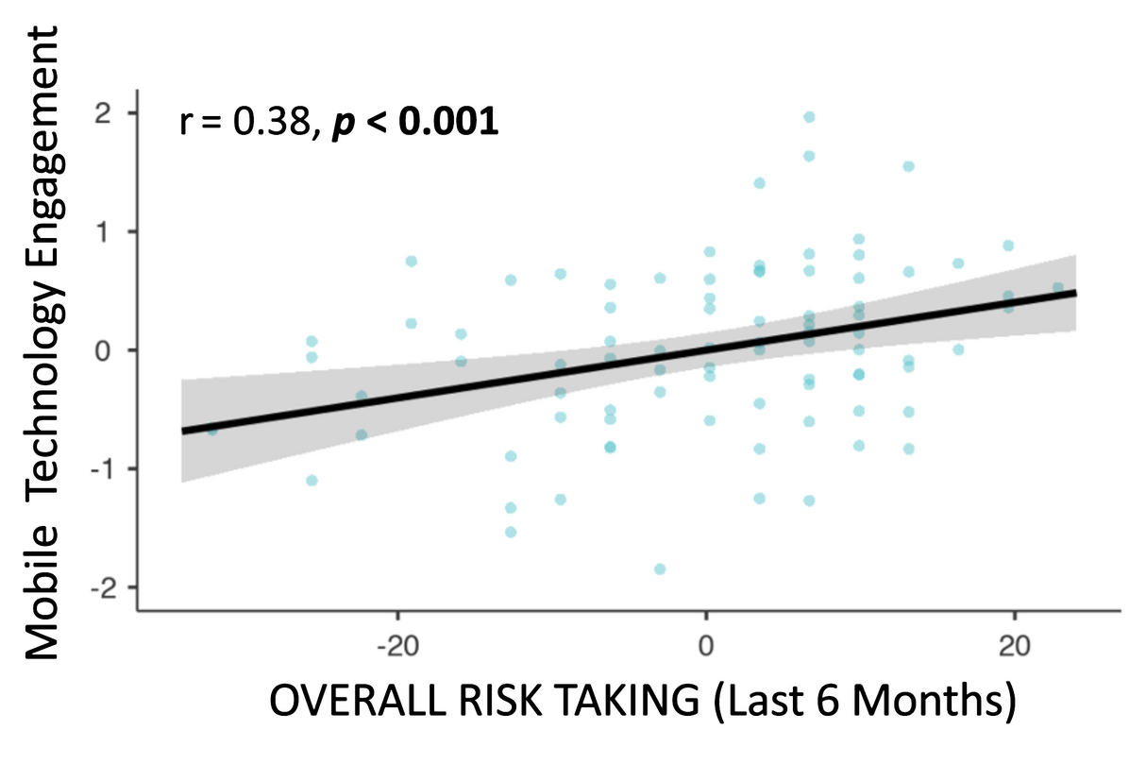
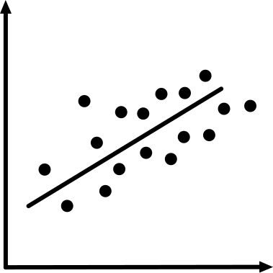
Background

Slide 8
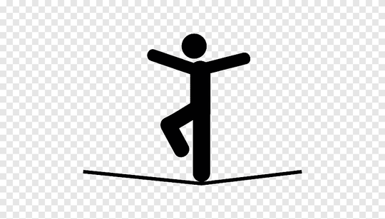
Background
• Substance involvement (Ohannessian et al., 2017).
• Unhealthy dietary behavior (Prybutok et al., 2024).
• Gambling (Savolainen & Oksanen, 2024).
• Sexual risk-taking (Doornwaard et al., 2014; Landry et al., 2017).
• Anti-social behavior (Baker & Pelfrey, 2016; Espinosa & Clemente, 2010; Tsitsika et al., 2014).
• Prosocial risk-taking (Van Teunenbroek et al., 2021).
• Consistent findings across studies (Boniel-Nissim et al., 2022; Kaur et al., 2020).
• Unclear mechanisms and directionality (Liu et al., 2023).

Slide 9
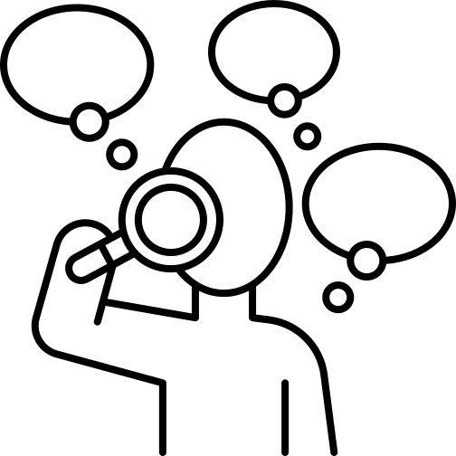
Background
Some theories: What Drives the Relationship Between SSM and Risk-Taking?
Exposure to Risky Behaviors – SSM increases exposure to risky actions, reinforcing social modeling and peer influence (Zheng et al., 2021; Geusens & Beullens, 2021).
Some research suggests SSM preceeds risk behavior (temporal pattern).

Slide 10
Background
Some theories: What Drives the Relationship Between SSM and Risk-Taking?
Exposure to Risky Behaviors – SSM increases exposure to risky actions, reinforcing social modeling and peer influence (Zheng et al., 2021; Geusens & Beullens, 2021).
Some research suggests SSM preceeds risk behavior (temporal pattern).
No Causal Link? – The relationship may be driven by a third variable.
Reverse direction? Risk-takers may be more likely to use SSM. (Is SSM itself a risk behavior?)

Slide 11
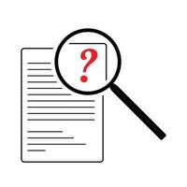
Background
Some theories: What Drives the Relationship Between SSM and Risk-Taking?
Exposure to Risky Behaviors – SSM increases exposure to risky actions, reinforcing social modeling and peer influence (Zheng et al., 2021; Geusens & Beullens, 2021).
Some research suggests SSM preceeds risk behavior (temporal pattern).
No Causal Link? – The relationship may be driven by a third variable.
Reverse direction? Risk-takers may be more likely to use SSM. (Is SSM itself a risk behavior?)
Cognitive Mechanisms – SSM use is linked to higher sensation-seeking and impulsivity, which drive risk-taking (Dou et al., 2020).

Slide 12
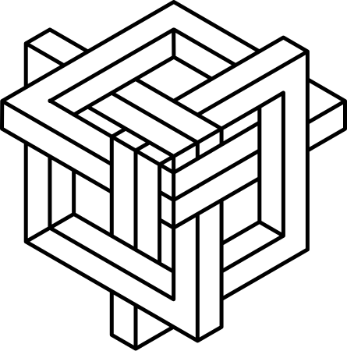
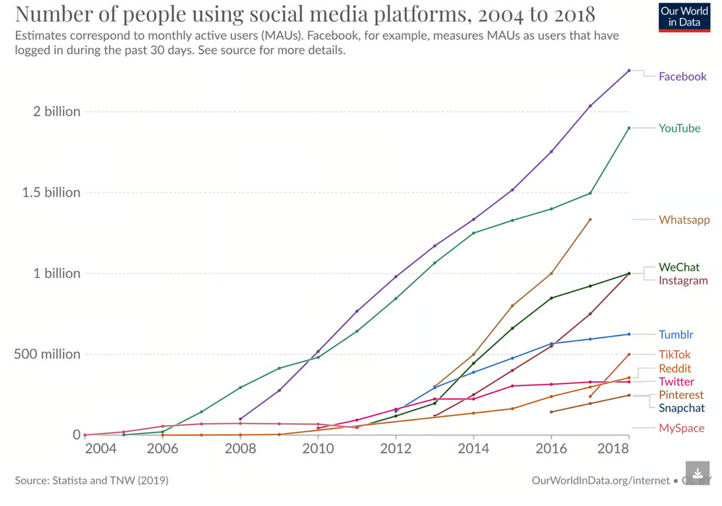
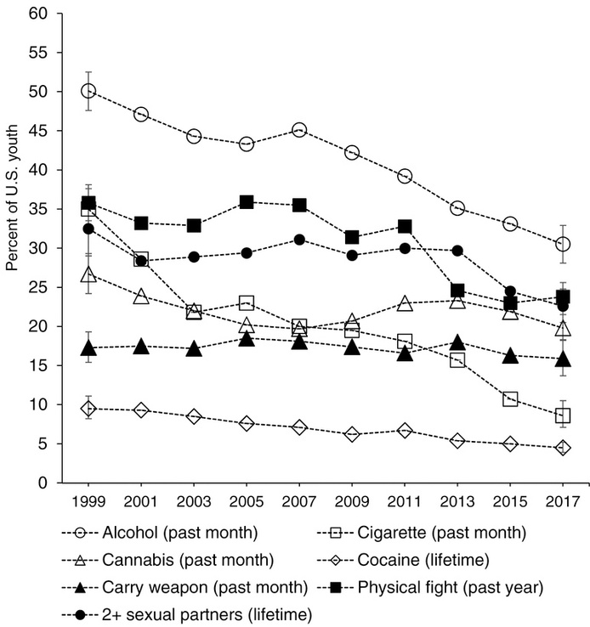
The Paradox!!

Slide 13

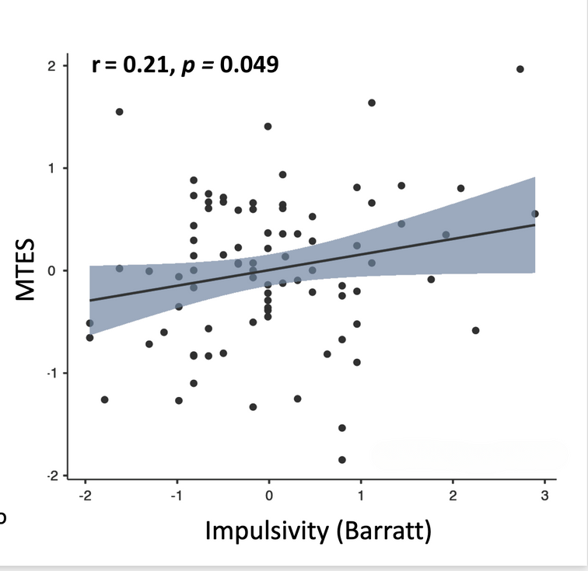
Background:
SSM and mechanisms of risk
A growing body of literature has demonstrated reliable relationships between SSM and impulsivity, and between ssm and reward sensitivity
Weaker self-regulation and executive functioning (Wilmer & Chein, 2016).
Impulsivity and instant gratification tendencies (Minear et al., 2013; Sanbonmatsu et al., 2013).
Attention deficits (Wilmer & Chein, 2016).
Reduced ACC gray matter (Loh & Kanai, 2014).
Heavy SSM use associated with altered PFC activity during cognitive tasks (Moisala et al., 2016).

Slide 14
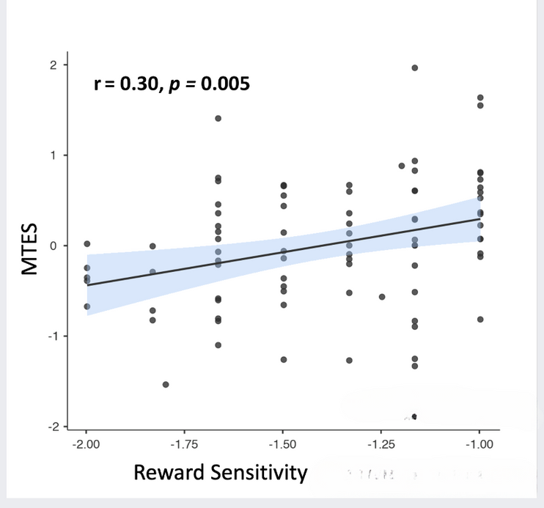
Background:
SSM and mechanisms of risk
A growing body of literature has demonstrated reliable relationships between SSM and impulsivity, and between ssm and reward sensitivity
Greater sensationation seeking (Sanbonmatsu et al., 2013).
Increased delay discounting (Hadar et al., 2015).
Media multitasking does not satisfy cognitive needs but provides emotional gratification (Wang & Tchernev, 2012).
Stronger sensitivity to immediate rewards in heavy SSM users (Hadar et al., 2017; Tang et al., 2017).
Weaker reward reinforcement learning associated with SSM habits (Meshi et al., 2019).

Slide 15
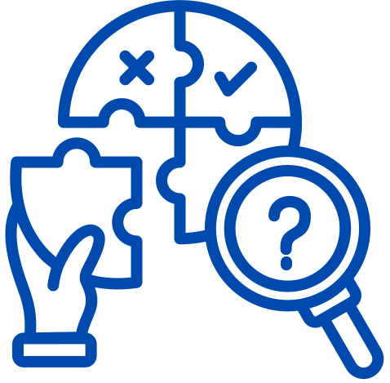
Existing gaps in the literature
Better indices for measuring social media use
Examining risk mechanisms, risk-taking, and social media together
Distinguishing positive vs. negative risk-taking
Comparing high- vs. low-stakes risk behavior

Slide 16
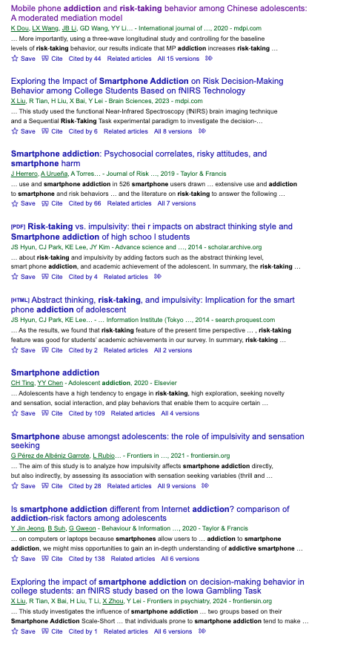
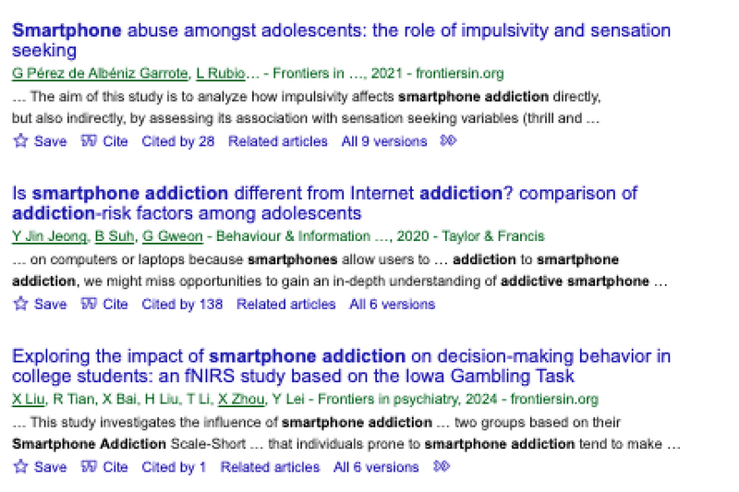
SSM use or SSM addiction?

Slide 17
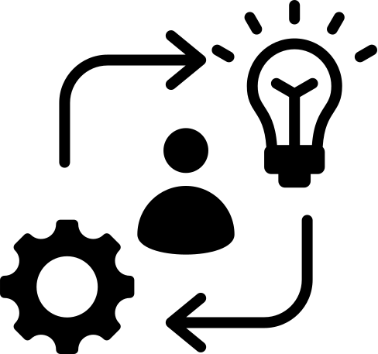
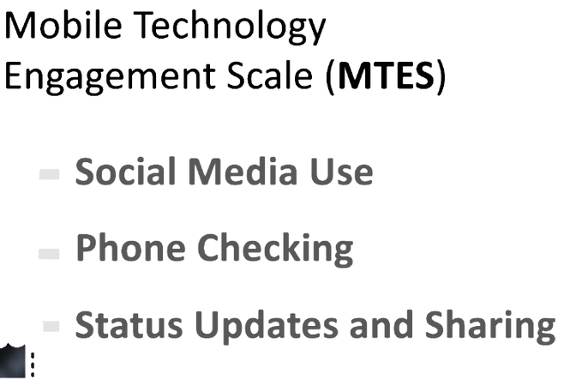
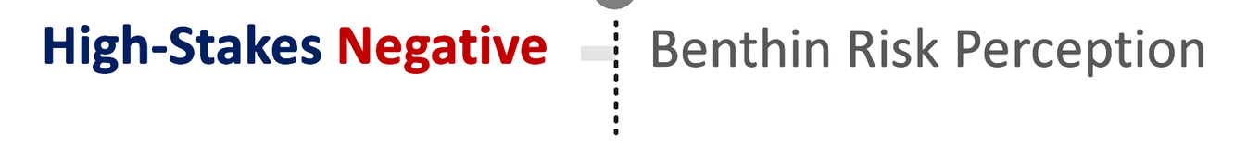
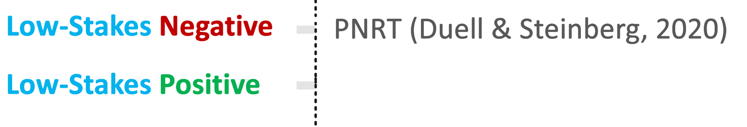
Method
Risk Taking
SSM

Slide 18
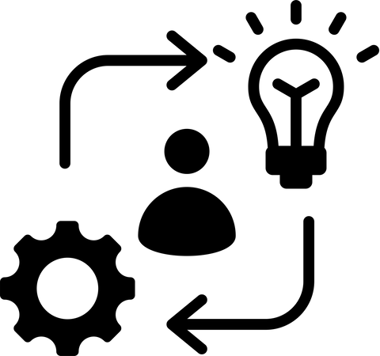
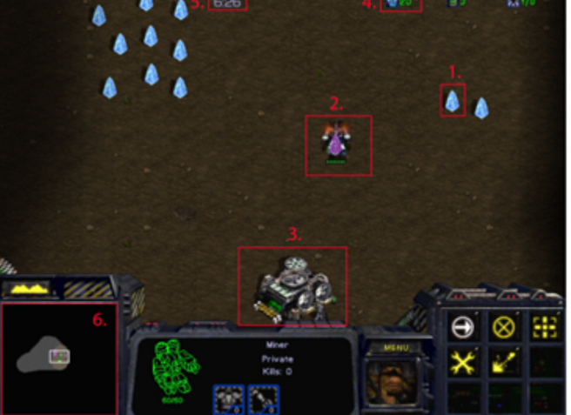
Method
Sensation seeking: Zuckerman
Impulsivity: Barrats
Reward/Exploring:

Slide 19

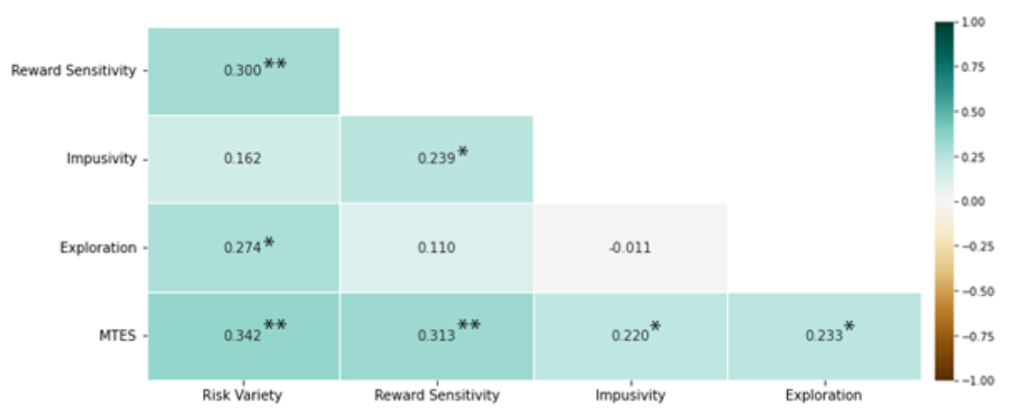
Results
The relationship between overall risk, SSM, reward, and impulsivity
Reward sensitivity and impulsivity were moderately correlated (r = .24, p = .026).
Exploration was linked to risk-taking (r = .28, p = .01) and MTES scores (r = .23, p = .028).
Risk variety correlated with reward sensitivity (r = .30, p = .005) and MTES (r = .34, p = .001).
MTES was significantly correlated with impulsivity (p < .01), reward sensitivity (p < .01), exploration (r = .23, p = .028), and risk variety (r = .34, p = .001).

Slide 20
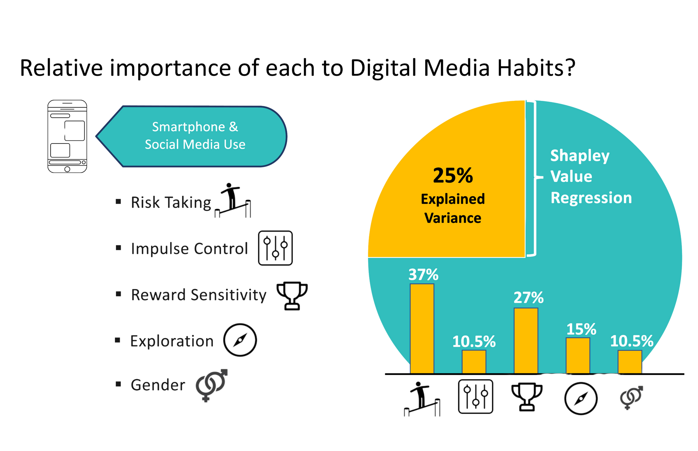
Results:
Shapley regression: what predicts variance in SSM?

Slide 21
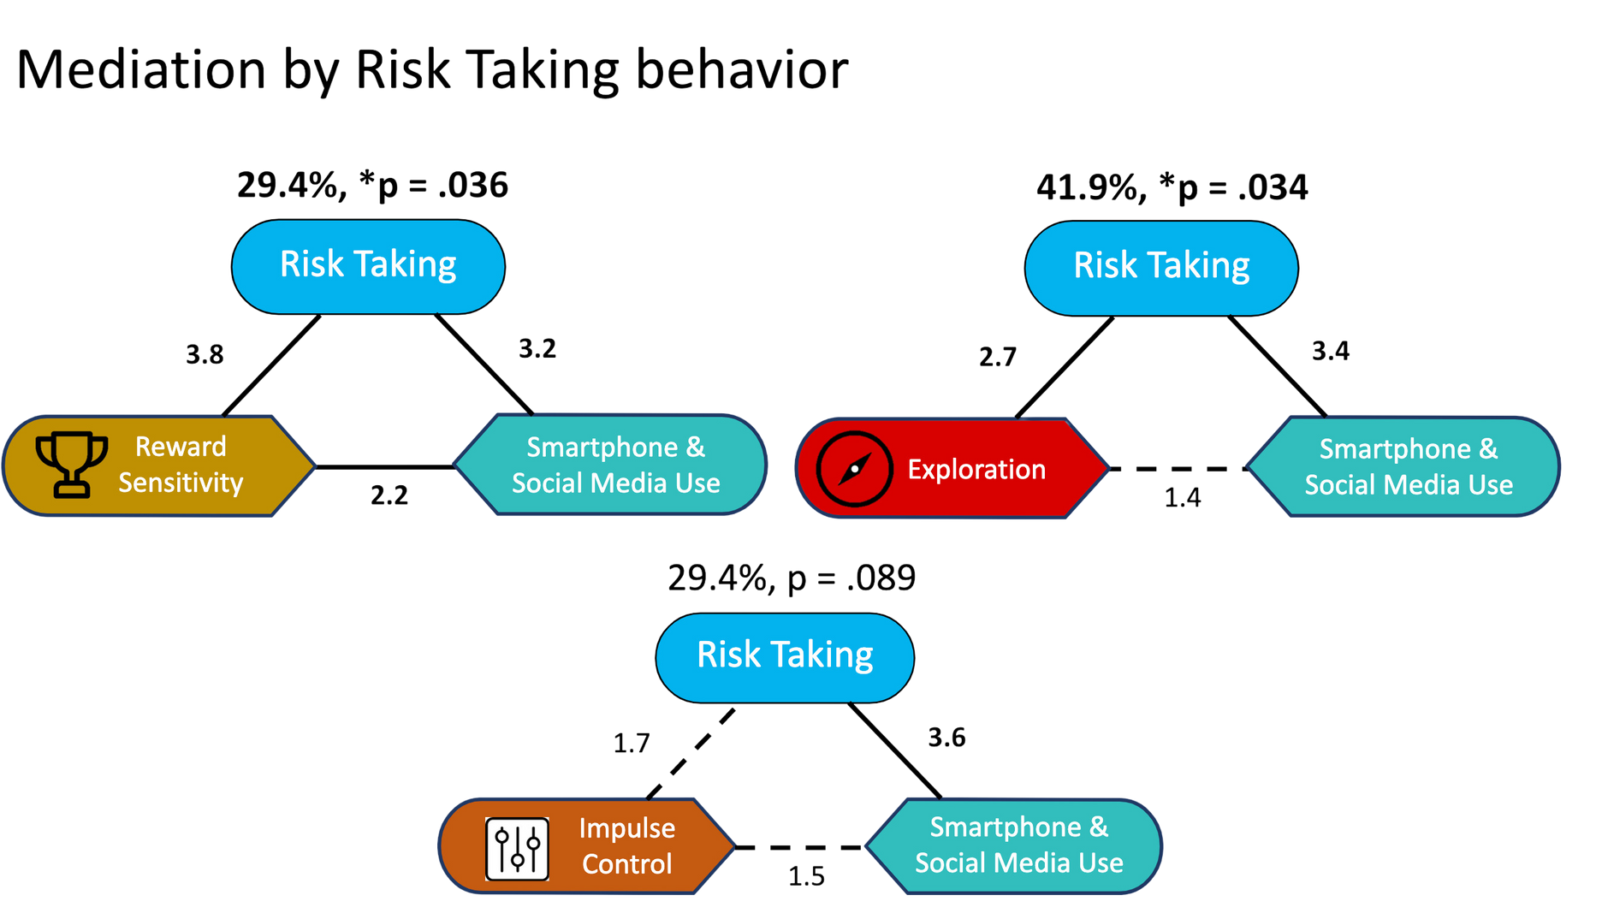
Results:
Mediation analyses - is rask taking driving the relationship between SSM and assosciated cognitive mechanisms?

Slide 22
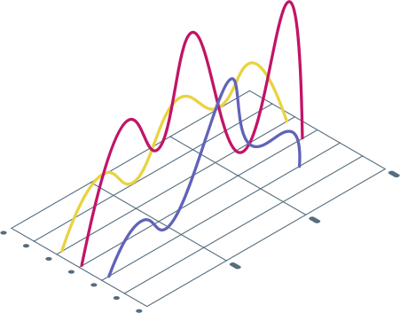
Results:
Regression: What about different forms of risk?
1. Control Variables (Sex)
2. Impulsivity
3. Sensation Seeking
4. Exploration
5. Risk-Taking Variables –
Low-stakes negative,
high-stakes negative,
positive risk-taking

Slide 23
Results:
Regression: What about different forms of risk?
1. Control Variables (Sex)
2. Impulsivity
3. Sensation Seeking
4. Exploration
5. Risk-Taking Variables –
Low-stakes negative,
high-stakes negative,
positive risk-taking

Slide 24
Results:
Regression: What about different forms of risk?
Sensation seeking was the strongest predictor of SSM use, explaining more variance than impulsivity and reducing its effect.
Exploration significantly predicted SSM use beyond sensation seeking, but its effect disappeared after adding risk-taking variables.
Low-stakes negative risk-taking was the strongest predictor of MTES (β = .26, p = .023), while high-stakes negative and positive risk-taking were not significant.

Slide 25
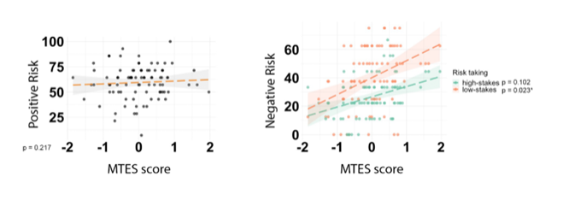
Results:
Regression: What about different forms of risk?

Slide 26
Discussion
SSM is related to risk, but we need MUCH more research to understand the why and how.
PUT ON YOUR SKEPTIC HAT! 🤔:
IS SOCIAL MEDIA REALLY DRIVING RISK BEHAVIOR? 🚦🔀 OR JUST ALONG FOR THE RIDE?

Slide 27
Results:
Regression: What about different forms of risk?
PUT ON YOUR SKEPTIC HAT! 🤔:
IS SOCIAL MEDIA REALLY DRIVING RISK BEHAVIOR? 🚦🔀 OR JUST ALONG FOR THE RIDE?
WE BROKE UP LEVEL AND TYPES OF RISK – WOULD THESE RELATIONSHIPS LOOK DIFFERENT IF WE DID THE SAME? 📊🔍

Slide 28
Results:
Regression: What about different forms of risk?
PUT ON YOUR SKEPTIC HAT! 🤔:
IS SOCIAL MEDIA REALLY DRIVING RISK BEHAVIOR? 🚦🔀 OR JUST ALONG FOR THE RIDE?
WE BROKE UP LEVEL AND TYPES OF RISK – WOULD THESE RELATIONSHIPS LOOK DIFFERENT IF WE DID THE SAME? 📊🔍
WHAT IF SMARTPHONE USE ITSELF IS A RISK BEHAVIOR? 📱⚠️ ARE RISK-TAKERS JUST MORE DRAWN TO SSM?

Slide 29
Results:
Regression: What about different forms of risk?
PUT ON YOUR SKEPTIC HAT! 🤔:
IS SOCIAL MEDIA REALLY DRIVING RISK BEHAVIOR? 🚦🔀 OR JUST ALONG FOR THE RIDE?
WE BROKE UP LEVEL AND TYPES OF RISK – WOULD THESE RELATIONSHIPS LOOK DIFFERENT IF WE DID THE SAME? 📊🔍
WHAT IF SMARTPHONE USE ITSELF IS A RISK BEHAVIOR? 📱⚠️ ARE RISK-TAKERS JUST MORE DRAWN TO SSM?
AND IF SO… WHY WOULD THAT BE? 🤷‍♂️ WHAT DOES THIS MEAN FOR HOW WE INTERPRET SSM RESEARCH?

Slide 30
